Slide 1
Infant Health Child Condition Based Phototherapy For Neonatal Jaundice Patient
TEAM MEMBERS :
Keerthi Shravan Kumar
Bathini Karthik
Gudiboina Rahul Sai
MD Adnan Mathin

Slide 2
Outlines
Introduction
Related Works
Problem Statement
Problem solution
Methodology
Block Diagram
Project Implementation
Conclusion
References

Slide 3
Introduction
Neonatal jaundice, characterized by high levels of bilirubin, can lead to irreversible brain damage and kernicterus in infants.
This condition affects 25% to 60% of full-term newborns and 80% of preterm newborns within the first two weeks of life.
Phototherapy, a common treatment, converts bilirubin into water-soluble compounds using light sources like LEDs.
LEDs, known for their efficiency and portability, emit blue light that overlaps with the peak spectrum of bilirubin breakdown.
Blue LEDs have shown potential in reducing treatment time for jaundiced infants.
However, prolonged UV exposure during phototherapy has been linked to an increased risk of cancer in infants and research on this association has yielded inconsistent results, necessitating further investigation.
Understanding the mechanisms behind phototherapy-induced adverse effects is crucial for developing safer treatment strategies.

Slide 4
Conti.
Novel treatments should aim to minimize the risk of skin damage and cancer development in neonates undergoing phototherapy.
Continued research in neonatal jaundice and LED phototherapy holds promise for enhancing neonatal care and pediatric healthcare practices. The development of innovative IoT-based systems using Arduino Uno and ESP32 microcontrollers enables real-time monitoring and personalized treatment, addressing the challenges of UV exposure and optimizing treatment outcomes.
By leveraging LED phototherapy and IoT-based systems, healthcare providers can offer safer and more effective care for neonatal jaundice. These advancements enable real-time monitoring and personalized treatment, ultimately improving treatment outcomes and reducing the risk of complications associated with UV exposure.

Slide 5
Related Works
S.no. | Tittle | Authors | Publication | Methodology | Challenges
1 | Neonatal phototherapy and future risk of childhood cancer | Juan Wang, Genxin Guo, Aimin Li. | 20 Jan 2021 | Phototherapy, jaundice, adverse reaction . | Rashes , retinal injury, Altered, hemodynamic.
2 | Neonatal phototherapy and future risk of childhood cancer | Nathalie Auger, Aimina Ayoub, Ernest Lo | 26 Jan 2019 | Jaundice, neonatal, neoplasms, phototherapy | Cancer
3 | Jaundice in newborn infants (Beyond the Basics) | Ronald J Wong, BA, Vinod K Bhutani, MD, FAAP | 31 Aug 2022 | Phototherapy | Skin rashes, loose stools, Overheating, dehydration.
4 | Phototherapy for neonatal jaundice | Marley Stewart, RN, Butterfly | November 2022 | SBR measurement, Direct Coombs test, Haemoglobin | Dehydration, Inadequate breastfeeding

Slide 6
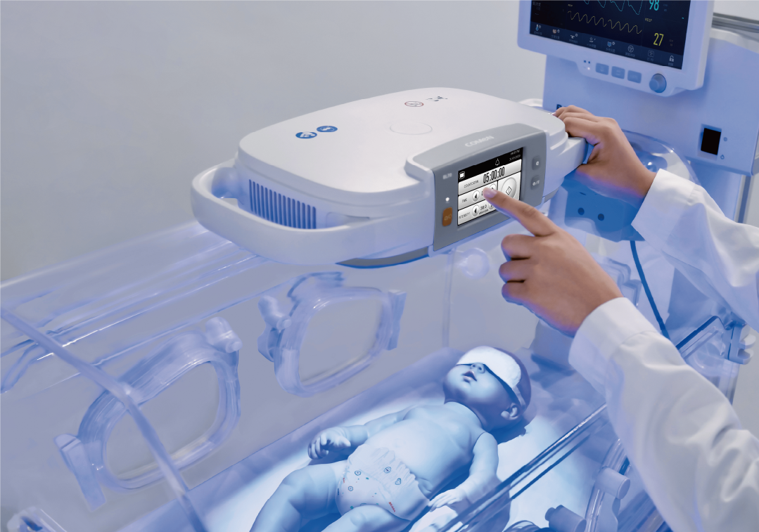
Problem Statement
Develop a child-friendly phototherapy solution to effectively treat neonatal jaundice in infants, addressing both medical efficacy and comfort, while minimizing potential risks and ensuring ease of use for healthcare providers and parents.

Slide 7
Problem Solution
The proposed solution employs UV light sources emitting specific wavelengths to facilitate the conversion of bilirubin into water-soluble compounds, aiding in their elimination from the infant's body. The Arduino Uno, ESP32 microcontroller acts as the central processing unit, regulating the intensity and duration of UV light exposure based on real-time bilirubin level measurements. These measurements are obtained through non-invasive sensors placed on the infant's skin.
IoT technology is leveraged to transmit the collected data to a cloud-based platform, allowing healthcare providers and parents to remotely monitor the infant's progress. The cloud platform also facilitates the analysis of historical data, enabling personalized treatment adjustments and early intervention if necessary.

Slide 8
Objectives
The major goal is to maximize the effectiveness and safety of care while treating neonates for neonatal jaundice.
Tailored Care: For exact neonatal care, adjust phototherapy.
Protection: Reduce the likelihood of serious consequences from jaundice.
Safety Assurance: Make sure there is constant observation in order to react quickly.
Restoring healthy skin color through proven therapy: Effective bilirubin control.
Non-Invasive Care: Treatment that is well-tolerated, painless, and devoid of invasive procedures.
Parental Involvement: Being actively involved strengthens relationships and self-assurance.
Effective Cost Control: Reduced length of stay and more house options improve affordability.
Preventing complications is essential to preventing serious outcomes from newborn jaundice.

Slide 9
Methodologies
Bilirubin Input: By using a 4x4 keypad to enter the baby's condition-related bilirubin levels.
The bilirubin data is received by Arduino UNO so as to quickly analyse and make further decisions.
Adjust the UV rays based on bilirubin levels using an L298N motor driver. The UV light is obtained from a 12V LED.
Collecting vital signs like temperature, heart rate, and weight and simultaneously sending the bilirubin readings to ESP32 for central processing.
To make decision about UV light regulation, carefully review data on weight, temperature, heart rate, and bilirubin value.
Real-time presentation of treatment parameters and vital signs on a 16x2 LCD display.
Safely transfer all of the dataset including vital signs to the BLYNK IoT platform.
Constantly improve the process in response to input, placing a focus on safety, effectiveness, and customized treatment.

Slide 10
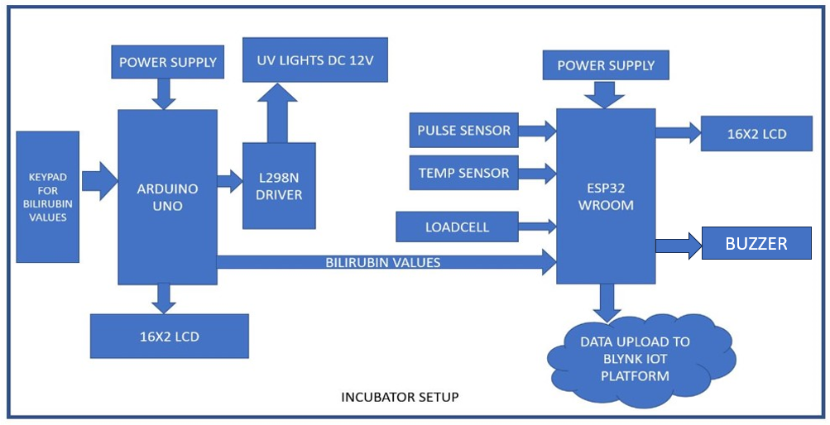
Block Diagram

Slide 11
Project Implementation
Execution
Input System: Bilirubin levels entered via keypad for treatment initiation.
Control Mechanism: Arduino Uno manages UV lamp parameters using an L298N driver.
Data Collection: ESP32 gathers vital signs like weight, temperature, and heart rate concurrently.
Treatment Customization : UV light adjustments based on bilirubin levels and vital signs for personalized treatment.
Data Analysis: ESP32 processes a comprehensive dataset, optimizing UV parameters for effective treatment.
Real-time Feedback: Treatment progress and UV parameters displayed on a 16x2 LCD screen for immediate feedback.
Remote Monitoring: Secure data transmission to the BLYNK IoT platform enables real-time monitoring via a smartphone app.

Slide 12
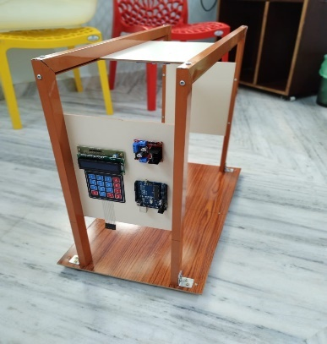
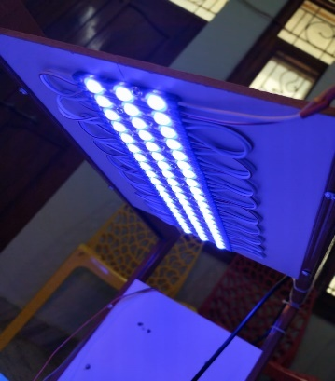
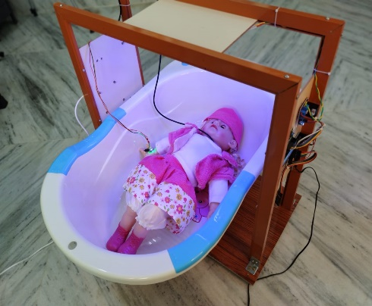
Project Implementation
Testing
The project was rigorously tested using a baby prototype to ensure accuracy, safety, and functionality. Every component was examined, and various scenarios were simulated to assess real-life effectiveness, prioritizing the baby's safety.
Fig (a) Entering the bilirubin values through the keyboard, (b) LED panel for UV rays for the phototherapy treatment., (c) Cradle with infant for Phototherapy treatment.
(a)
(b)
(c)

Slide 13
Conclusion
In conclusion, the integration of UV lights, Arduino UNO, ESP32, and IoT technology presents a promising avenue for improving neonatal jaundice treatment. This approach holds the potential to revolutionize infant health monitoring and provide a higher quality of care for neonates affected by jaundice, ultimately contributing to better health outcomes in the early stages of life.
The blue LED UV light treatment that is phototherapy treatment is most effective & less costly treatment for the new born babies. The recovery rate is fast as compare to conventional methods. This treatment is easy and can be used to newborns. The doctors & nurses can monitor the patients data through Internet on laptop, Smart Mobiles using IoT & Wi Fi Module.

Slide 14
References
Niteen Vaijnath Kamble, a Review Paper on Ultra- Violet (UV) Light Treatment on Jaundice in Newborn Babies International Journal of Scientific Research in Engineering and Management (IJSREM) Volume: 04 Issue: 06, June -2020 ISSN: 2582-3930.
C. Henny-Harry and H. Trotman, Epidemiology of Neonatal Jaundice at the University Hospital of the West Indies, The West Indian Medical Journal, vol. 61(1), pp. 37-42, 2012.
T. Slusher, L. Day, T. Ogundele, N. Woolfield, and J. Owa Filtered sunlight, solar powered phototherapy and other Strategies for managing neonatal jaundice in low-resource settings, Early Human Development, pp. 114:11-15, Nov.2017, doi: 10.1016/j.earlhumdev.2017.09.008.Epub 2017
A. Hasler, I. Talzi, C. Tschudin and S.gruber, “Wireless Sensor Networks in Permaforst research-concept, requirements, implementation and challenges”, in Proc. 9th Int. Conf. Permafrost, Jun 2008, Vol1, pp. 669-674.
R. Torres, D. Battaglino, and L. Lepauloux, “Baby Cry Sound Detection: A Comparison of Hand Crafted Features and Deep Learning Approach,” in Engineering Applications of Neural Networks, vol. 744, G. Boracchi, L. Iliadis, C. Jayne, and A. Likas, Eds. Cham: Springer International Publishing, 2017, pp. 168–179. doi: 10.1007/978-3-319-65172-915.

